Slide 1



Sustainability Analysis
Symbiosis Institute Of Technology, Nagpur
Prakriti Kumari
Pritam Morey
Taniksha Upadhyay

Slide 2
Problem Statement
Analyze IKEA's sustainability initiatives to understand the relationships between environmental, social, and economic impacts, and identify key factors driving effective outcomes. Use data-driven insights to recommend strategies for improving sustainability performance.
Objectives
Evaluate the effectiveness of sustainability initiatives of IKEA.
Recognizing the essential factors for expected results.
Find correlations among cost, CO2 emission reduction, and revenue.
Recommendations for Improvements.

Slide 3
Dataset Overview(Optional)
The dataset contains sustainability initiatives at IKEA, focusing on both environmental and financial aspects. It provides insights into the performance and impact of various sustainability programs.
Key Columns:
Initiative_ID: Unique identifier for each sustainability initiative (e.g., 'IKEA_40').
Category: The type or category of sustainability initiative (e.g., 'Energy Efficiency', 'Waste Management').
Cost: The cost associated with each initiative (numeric).
Revenue_Impact: The financial revenue generated or saved due to the initiative (numeric).
CO2_Reduction: The amount of CO2 emissions reduced as a result of the initiative (numeric).
Waste_Reduction: The amount of waste reduced through the initiative (numeric).
Renewable_Energy_Usage: Percentage of energy used from renewable sources in the initiative (numeric).
Customer_Engagement: The level of customer engagement or awareness raised by the initiative (numeric).
Employee_Engagement: The level of employee involvement in sustainability initiatives (numeric).

Slide 4
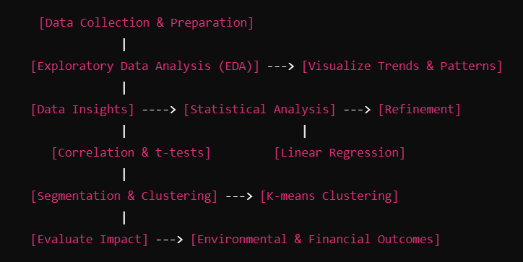
Methodology
Data-Driven Decision Process:

Slide 5
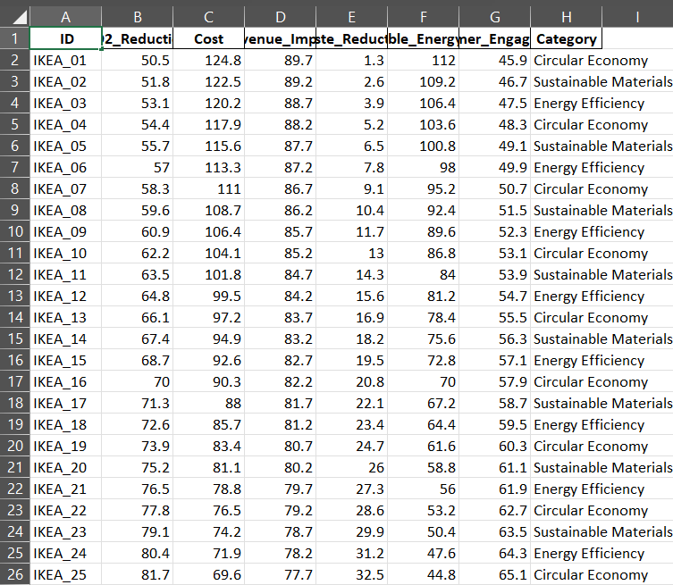
Type: Data on sustainability initiatives.
Key Columns:
Renewable Energy Usage: Percentage from renewable sources.
Revenue Impact: Financial impact of initiatives.
Waste Reduction: Measure of waste reduction.
Purpose: Analyzing relationships between energy usage, waste reduction, and financial outcomes.
Data: Mix of numeric and categorical for visual analysis.

Slide 6
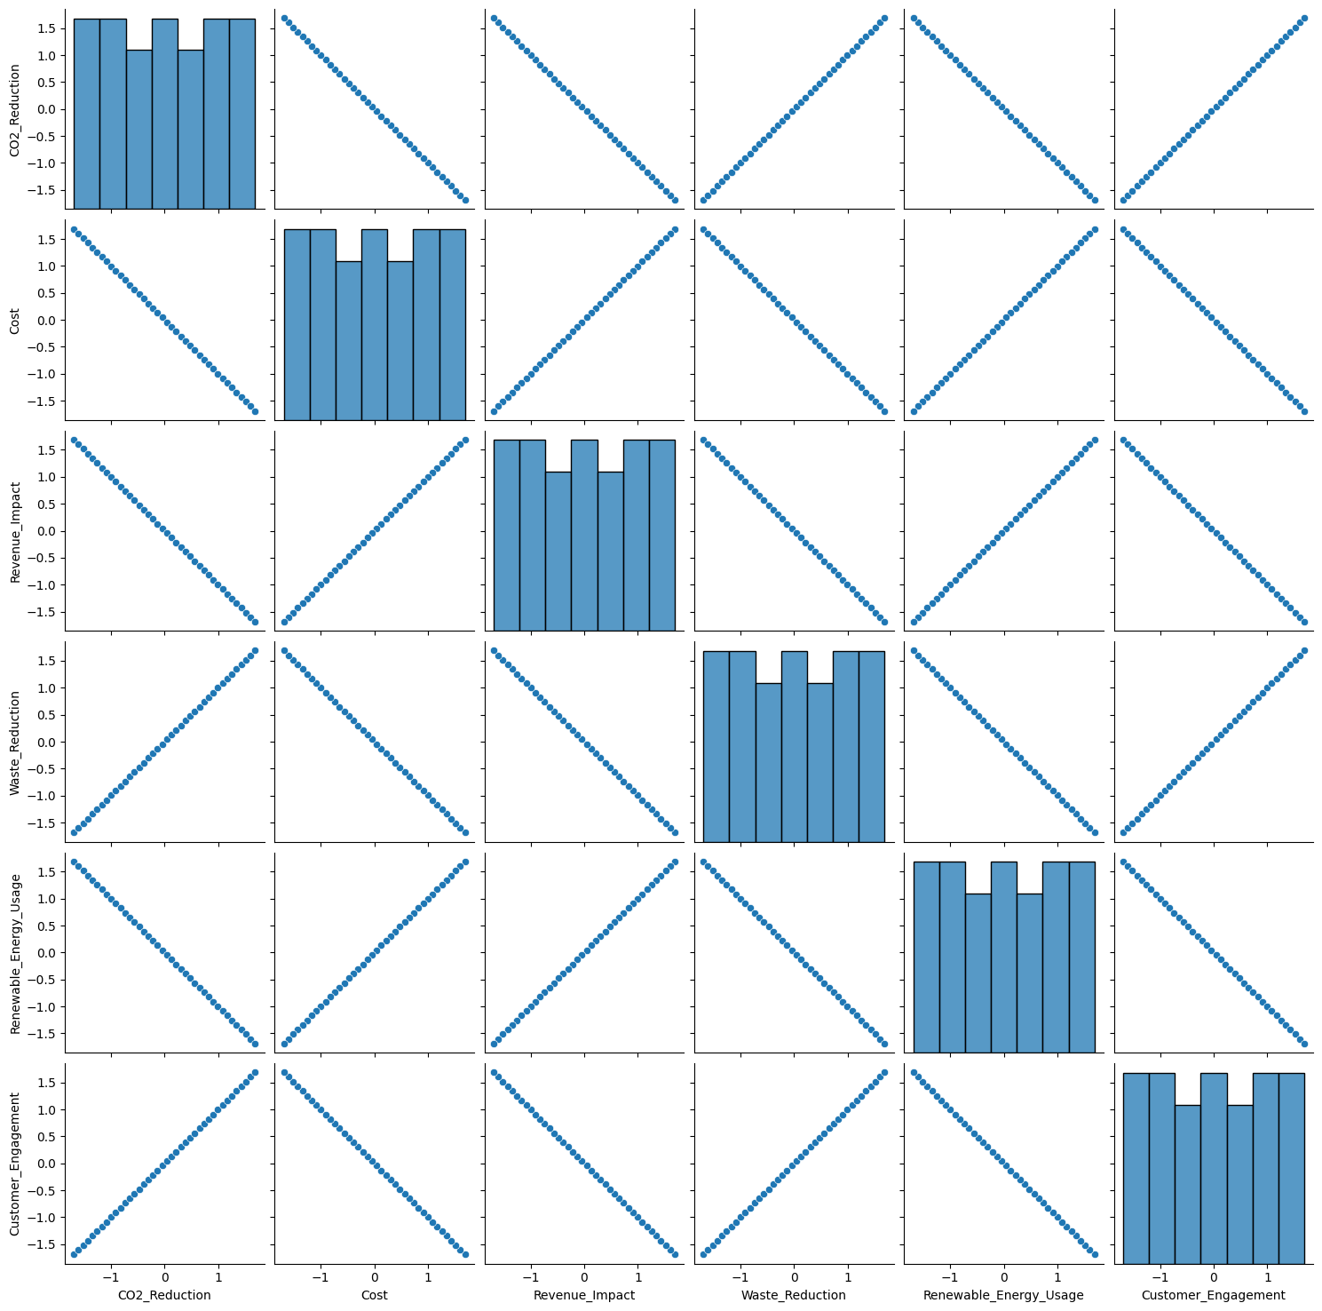
The uploaded image shows a pair plot generated using sns.pairplot() from the Seaborn library, visualizing relationships among numerical variables in a dataset.Each diagonal represents histograms (or kernel density plots) of individual variables, while the off-diagonal subplots show scatter plots representing pairwise relationships between the variables.

Slide 7
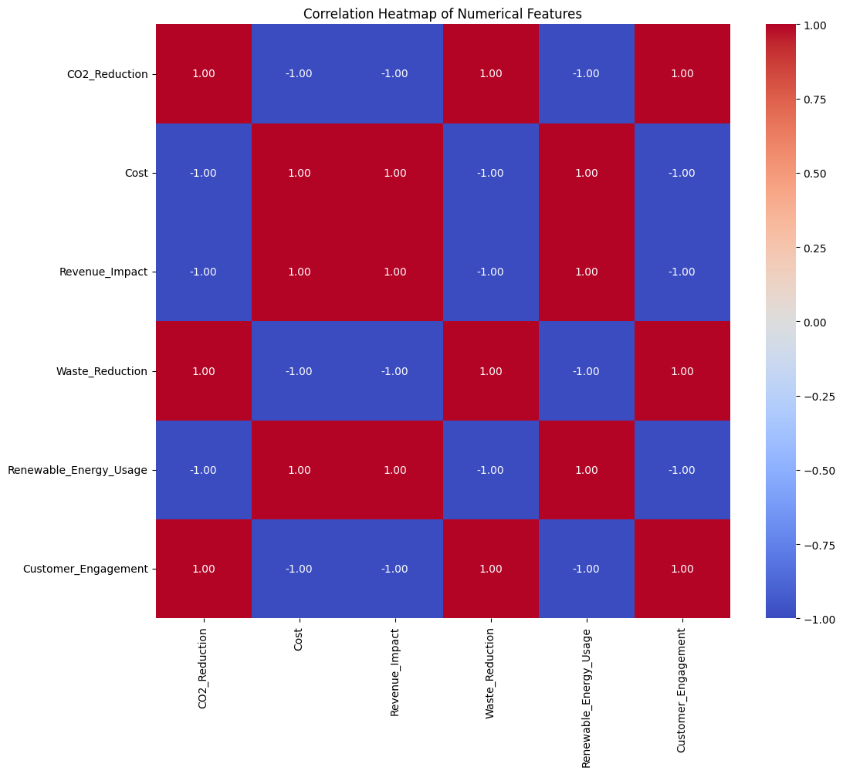
The heatmap visualizes the correlations between numerical features in the dataset:
Axes: Both the x-axis and y-axis represent the numerical columns.
Colors: Red tones indicate strong positive correlations (close to +1).
Blue tones indicate strong negative correlations (close to -1).
White or neutral shades indicate weak or no correlation (close to 0).
Annotations: Each cell displays the exact correlation value, formatted to two decimal places.
Insights:Identify features with strong positive relationships (e.g., values close to 1).
Spot features with strong negative relationships (e.g., values close to -1).
Weak or no relationships appear close to 0.

Slide 8
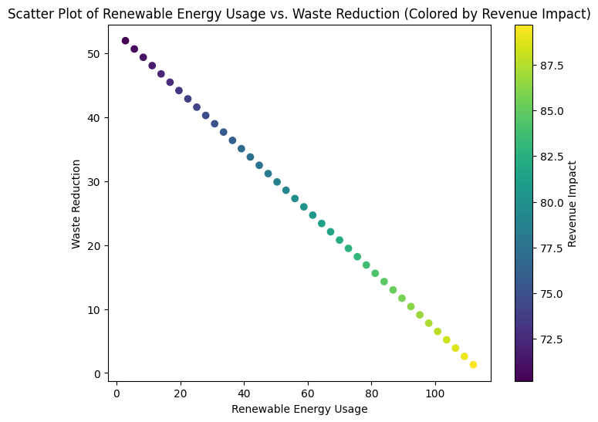
Key Features:
Position: Each point represents a dataset entry.
Color: Bright yellow-green indicates higher revenue impact, while darker shades indicate lower impact.
Insights: Patterns or clusters may reveal how revenue impact varies with energy usage and waste reduction.
This plot highlights potential trends or correlations among the variables.

Slide 9
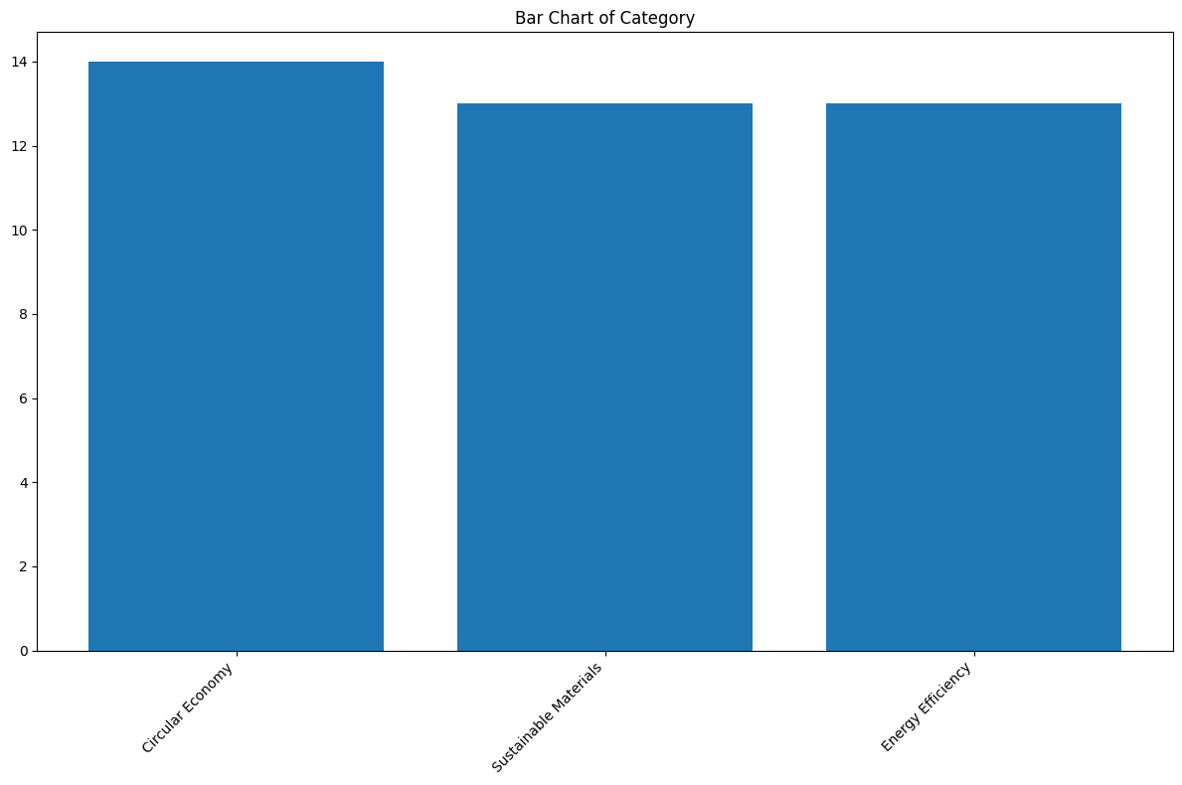
Key Features:X-axis: Categories in the column.
Y-axis: Count of occurrences for each category.
Insights: Highlights the most and least frequent categories in the dataset.
Rotated x-axis labels improve readability for longer category names.

Slide 10
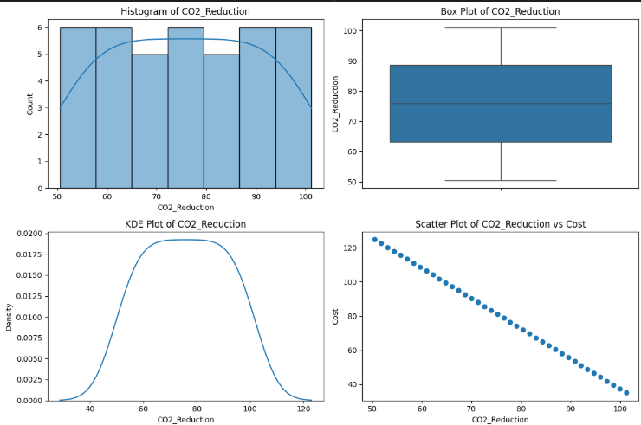

Slide 11
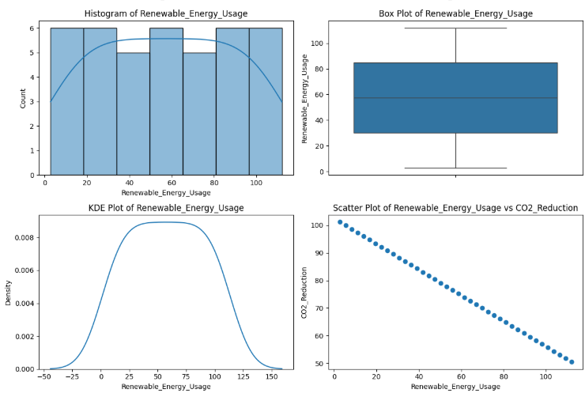

Slide 12
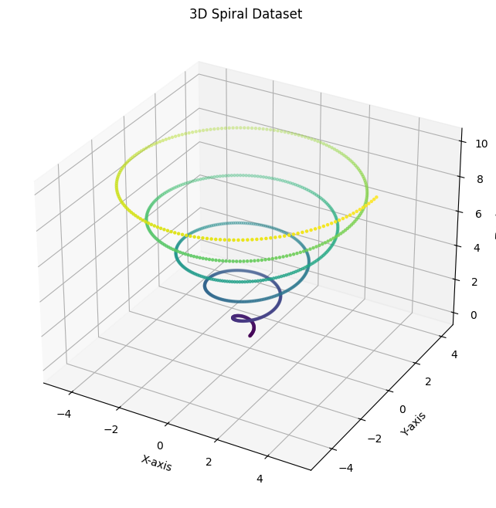
Key Features of the Graph:
X-axis and Y-axis: The dataset forms a spiral on the XY-plane, with the radius gradually increasing as the spiral completes multiple turns.
Z-axis: The points rise vertically along the Z-axis, creating a helical structure that spirals upward.
Color Gradient: The points are colored based on their angular position (theta), with the Viridis colormap applied to visually distinguish different parts of the spiral.
Points Distribution: The points are uniformly distributed along the spiral, with a smooth transition between the X, Y, and Z coordinates, providing a clear 3D representation.

Slide 13
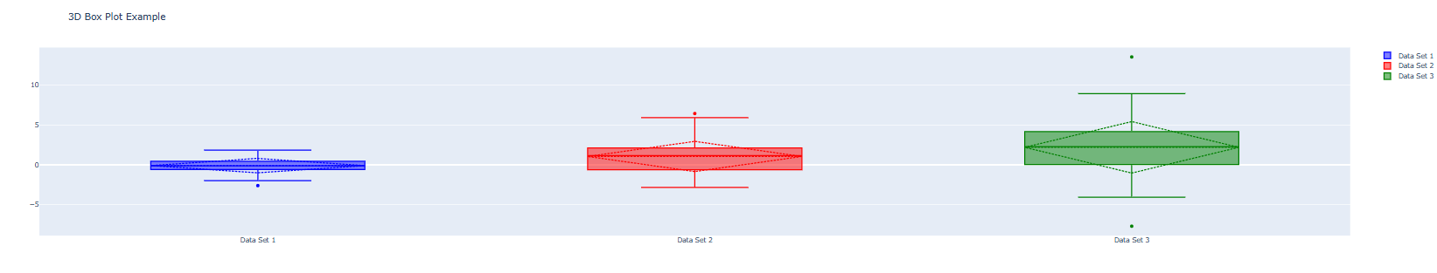
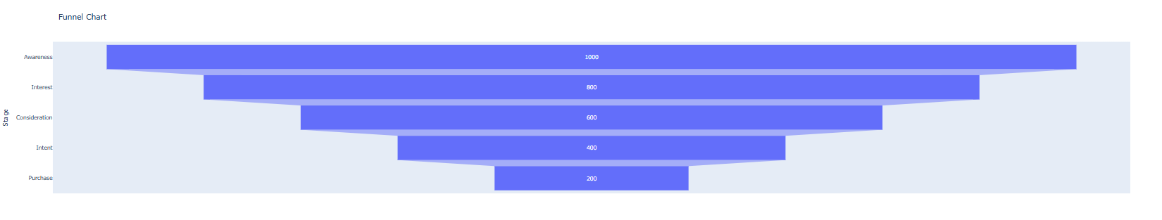
3D Box Plot
Funnel Chart

Slide 14
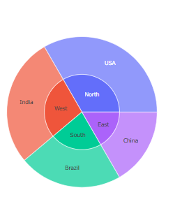
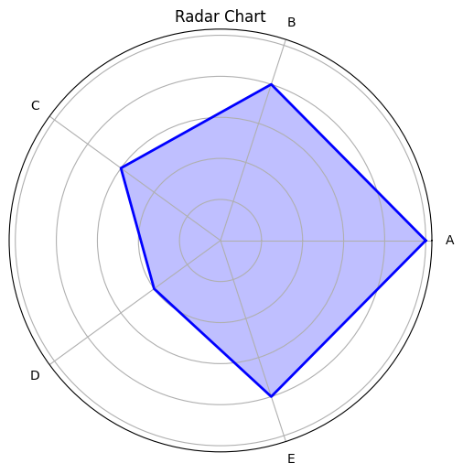
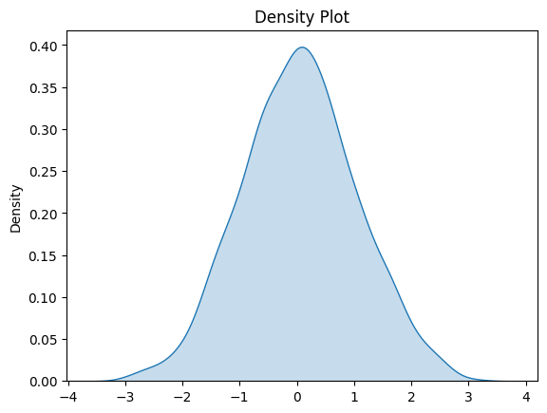
Sunburst Chart
Density Plot: A smooth, continuous version of a histogram, showing the distribution of a dataset and its probability density, often used to understand the underlying distribution of data.
Radar Chart
Sunburst Chart: A radial chart used to visualize hierarchical data, with each level represented by a ring, and inner rings showing broader categories while outer rings break down into subcategories.
Radar Chart: A graphical representation of multivariate data with multiple axes, where each axis represents a variable, and the data points are plotted along these axes to form a polygon.

Slide 15
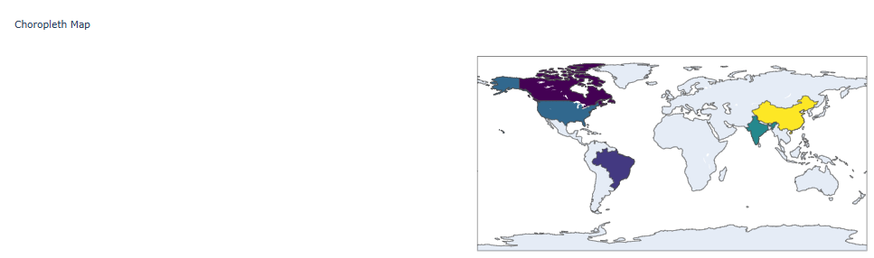

Choropleth MAP

Slide 16

Conclusion
Summary
IKEA’s sustainability initiatives demonstrate strong correlations between environmental, economic, and social impacts.
Key drivers include cost efficiency, renewable energy usage, and customer engagement.
Linear regression and clustering revealed actionable insights to prioritize high-impact initiatives.
Recommendations were made to optimize sustainability strategies and enhance outcomes.

Slide 17
Future Work
Broader Analysis: Expand the dataset to include more initiatives and global operations.
Real-Time Monitoring: Integrate IoT and real-time data tracking for continuous evaluation.
Emerging Technologies: Explore AI and machine learning to predict long-term sustainability impacts.
Comparative Studies: Benchmark IKEA's sustainability performance against industry peers.
Stakeholder Engagement: Assess the role of customer and community participation in driving impact.

Slide 18
References
IKEA Sustainability Report: https://www.ikea.com/ms/en_US/this-is-ikea/sustainable-everyday/sustainability-report
IKEA and Sustainability Practices (World Economic Forum): https://www.weforum.org/agenda/2021/01/how-ikea-is-becoming-more-sustainable/
Sustainability and Corporate Responsibility at IKEA: https://about.ikea.com/en/sustainability
Case Studies on IKEA’s Circular Economy (Ellen MacArthur Foundation): https://ellenmacarthurfoundation.org/case-studies/ikea-designs-for-circularity
IKEA Carbon Footprint Reduction: https://www.climateaction.org/news/ikea-reduces-carbon-footprint-while-increasing-sales
Sustainable Energy Goals at IKEA: https://www.reuters.com/business/sustainable-energy-ikea-2022

Slide 19
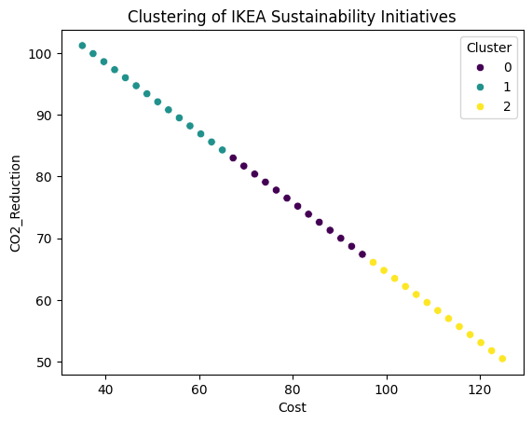
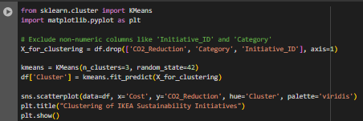
Result

Slide 20
Thank You!
Notes:
Thank You !!

